Slide 1
Topic: Measurement
EQ: How do I use formulas to calculate the surface area of cylinders?
GET ORGANISED for the new unit
Use the next 3 pages to fold and glue a folder for your worksheets
Unit Cover page- Measurement and glue in the learning goals
Write these page numbers in your contents page

Slide 2
Learning Intentions
Students will be able to
- Calculate the surface area of cylinders from a given diagram.
- Interpret a familiar worded question to draw a diagram, and calculate the surface area of cylinders.

Slide 3
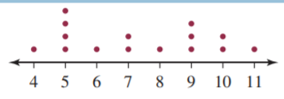
Starter – Daily 4 a bit shorter to start the new unit
1. Find the middle score of the following data set.
2. Which is the best buy: a 2-L bottle of soft drink for $5.30 or a 1.25-L bottle for $3.25?
3. Describe the steps involved in finding the surface area of a 3D shape.
4. Recall and construct a general method for finding the surface area of a 3D shape.

Slide 4
 | Goal-setting for Year 9 Measurement
Week/s | A | B | C | D
4 | Solves complex word problems involving surface area of cylinders and solid sectors, including inverse calculations. | Interprets a familiar worded question to draw a diagram, and calculate the surface area of cylinders and solid sectors. | Calculates the surface area of cylinders and solid sectors from a given diagram. | Incorrectly uses formula to perform calculation of surface area of cylinders and solid sectors.
5 | Solves complex word problems involving volume of cylinders and solid sectors, including inverse calculations. | Interprets a familiar worded question to draw a diagram, and calculate the volume of cylinders and solid sectors. | Calculates the volume of cylinders and solid sectors from a given diagram. | Incorrectly uses formula to perform calculation of volume of cylinders and solid sectors.

Slide 5
24
7
30
Topic: Measurement
Date:
EQ: How do I use formulas to calculate the surface area of cylinders?
Using your answer to Q4 on the previous slide consider what shapes are required to make a cylinder? Write a response.

Slide 6
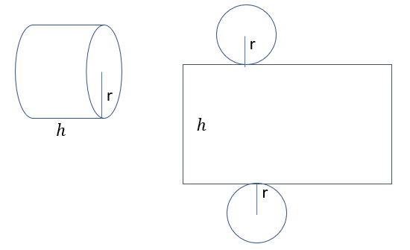
24
7
30
Topic: Measurement
Date:
EQ: How do I use formulas to calculate the surface area of cylinders?
What does the net of a cylinder look like?
The cylinder is formed from two circles and one rectangle
Look at the h and the r

Slide 7
24
7
30
Topic: Measurement
Date:
EQ: How do I use formulas to calculate the surface area of cylinders?

Slide 8
24
7
30
Topic: Measurement
Date:
EQ: How do I use formulas to calculate the surface area of cylinders?

Slide 9
24
7
30
Topic: Measurement
Date:
EQ: How do I use formulas to calculate the surface area of cylinders?

Slide 10


24
7
30
Date
Topic: Measurement
EQ: How do I use formulas to calculate the surface area of cylinders?
The cylinder is formed from two circles and one rectangle
$$Area=$$
$$h$$
25

Slide 11

24
7
30
Date
Topic: Measurement
EQ: How do I use formulas to calculate the surface area of cylinders?
The cylinder is formed from two circles and one rectangle
$$Area=πr^{2}$$
$$h$$
25

Slide 12

24
7
30
Date
Topic: Measurement
EQ: How do I use formulas to calculate the surface area of cylinders?
The cylinder is formed from two circles and one rectangle
Same length as the circumference of the circle
$$2πr$$
$$Area=πr^{2}$$
$$h$$
25

Slide 13
24
7
30
Date
Topic: Measurement
EQ: How do I use formulas to calculate the surface area of cylinders?
The cylinder is formed from two circles and one rectangle
Same length as the circumference of the circle
$$2πr$$
$$Area=πr^{2}$$
$$h$$
TSA = 2 circles + 1 rectangle
= ?????????
25

Slide 14
How do we find the SA of a Cylinder?

Slide 15
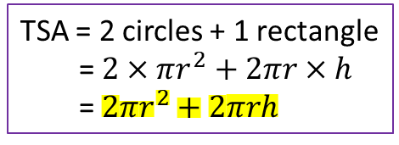
24
7
30
Date
Topic: Measurement
EQ: How do I use formulas to calculate the surface area of cylinders?
The cylinder is formed from two circles and one rectangle
Same length as the circumference of the circle
$$2πr$$
$$Area=πr^{2}$$
$$h$$
TSA = 2 circles + 1 rectangle
= $2×πr^{2}+2πr×h$
= $2πr^{2}+2πrh$
25

Slide 16
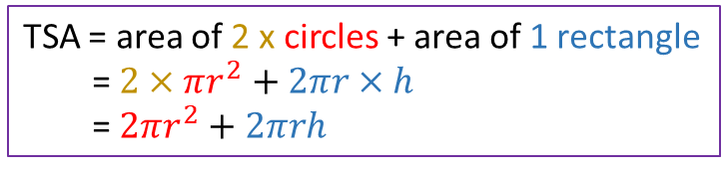
24
7
30
Date
Topic: Measurement
EQ: How do I use formulas to calculate the surface area of cylinders?
What is the net made up of?
The cylinder is formed from two circles and one rectangle
Same length as the circumference of the circle
We only need the radius and the height to calculate the SA of a cylinder
$$2πr$$
$$Area=πr^{2}$$
$$h$$
How do I find the Surface Area?
TSA = area of 2 x circles + area of 1 rectangle
= $2×πr^{2}+2πr×h$
= $2πr^{2}+2πrh$
25

Slide 17
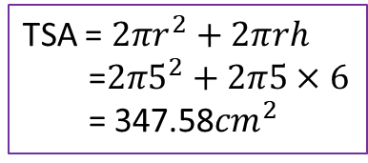
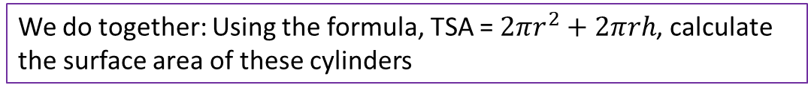
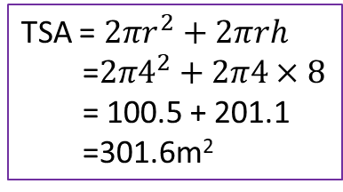

24
7
30
Date
Topic: Measurement
EQ: How do I use formulas to calculate the surface area of cylinders?
We do together: Using the formula, TSA = $2πr^{2}+2πrh$, calculate the surface area of these cylinders
5cm
TSA = $2πr^{2}+2πrh$
=$2π5^{2}+2π5×6$
= 347.58${cm}^{2}$
6cm
TSA = $2πr^{2}+2πrh$
=$2π4^{2}+2π4×8$
= 100.5 + 201.1
=301.6m²
8m
$$12m$$
19

Slide 18
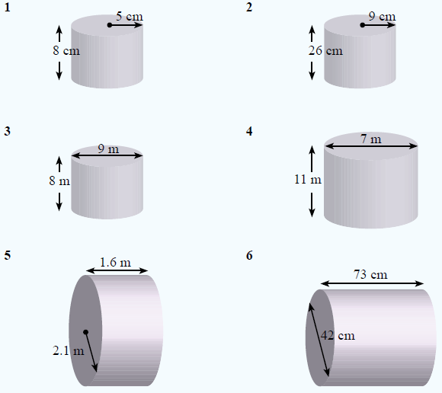
Complete exercise 3.8 on page 39.

Slide 19
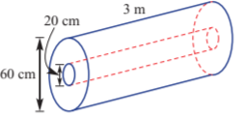
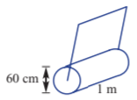
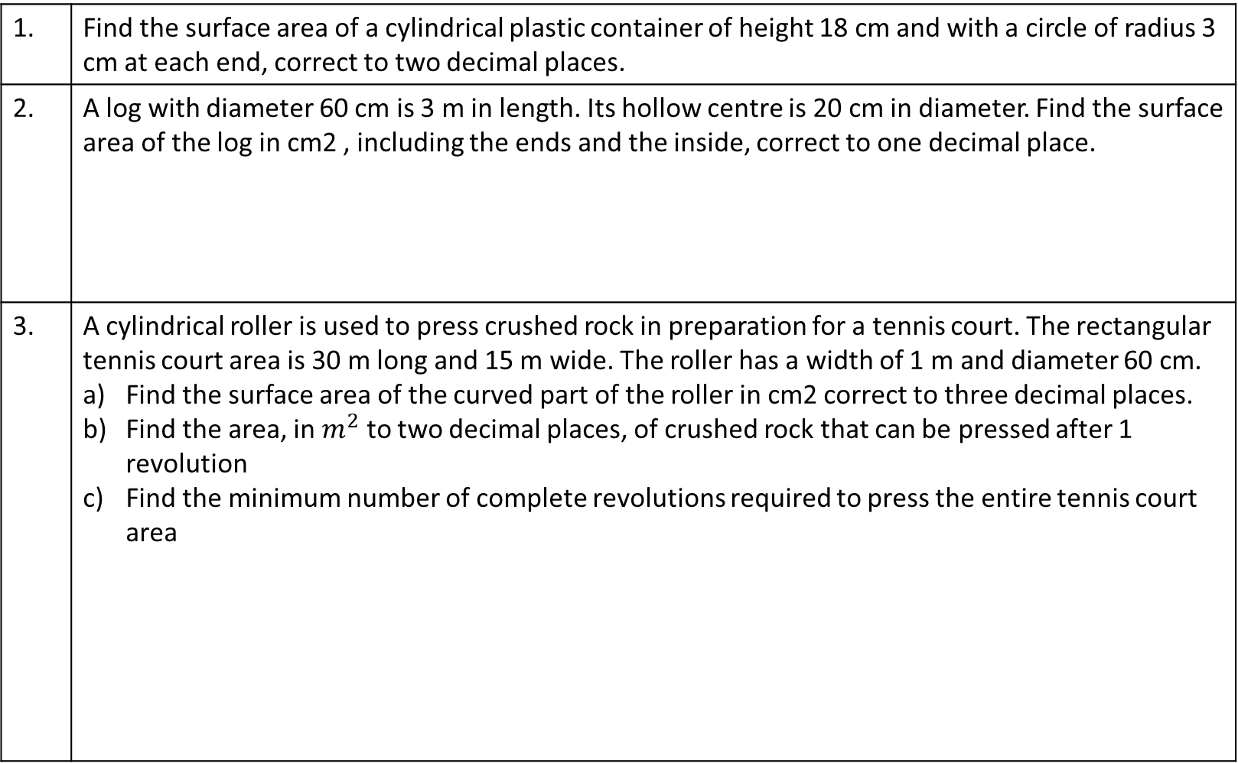
Worded Questions
1. | Find the surface area of a cylindrical plastic container of height 18 cm and with a circle of radius 3 cm at each end, correct to two decimal places.
2. | A log with diameter 60 cm is 3 m in length. Its hollow centre is 20 cm in diameter. Find the surface area of the log in cm2 , including the ends and the inside, correct to one decimal place.
3. | A cylindrical roller is used to press crushed rock in preparation for a tennis court. The rectangular tennis court area is 30 m long and 15 m wide. The roller has a width of 1 m and diameter 60 cm. Find the surface area of the curved part of the roller in cm2 correct to three decimal places. Find the area, in $m^{2}$ to two decimal places, of crushed rock that can be pressed after 1 revolution Find the minimum number of complete revolutions required to press the entire tennis court area
1. | 395.84 cm 2
2.

Slide 20
ANSWERS Worded Questions
1. | 395.84 cm 2
2. | 80 424.8 cm2
3. | a 18 849.556 cm2 b 1.88 m2 c 239

Slide 21

Exit pass. Answer the following on a piece of paper and hand it in to your teacher.
Calculate the SA of the following cylinder.
18m
$$21m$$

